Slide 1
Final Project
Tadeo Salinas
José Rodríguez
Mauricio Ruiz
Juan Coronado

Slide 2
Non Supervised model ML
Supplier classification at Joyson Safety - Takata (Real data)

Slide 3
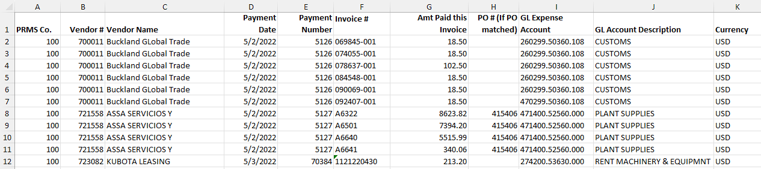
Purpose
Based on supplier payment activity during may 2022 through may 2023, the purpose is to classify using a non supervised model for ML to all suppliers on rankings AAA, AA and A. Where AAA supplier is the rank for those supplier with the most important operation, not only per supplier also done by supplier category.
Database used This database includes list all supplier payments transactions for a total of 70k+ payments, is also including supplier categories, since we have many, we decided to use the 5 top expense categories.

Slide 4
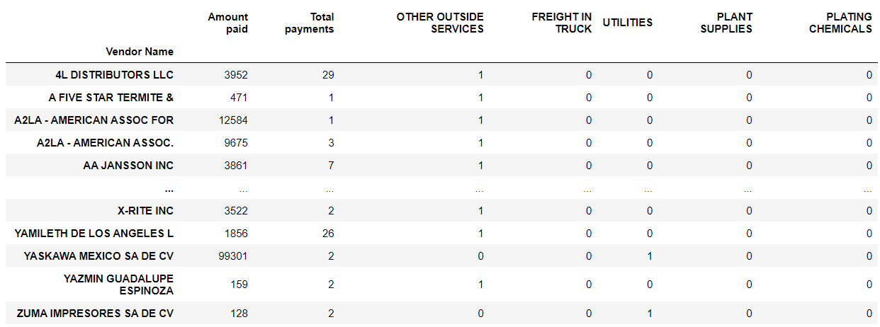
Dummy model
A dummy model in machine learning is a simple, baseline model used to compare the performance of more complex models.

Slide 5
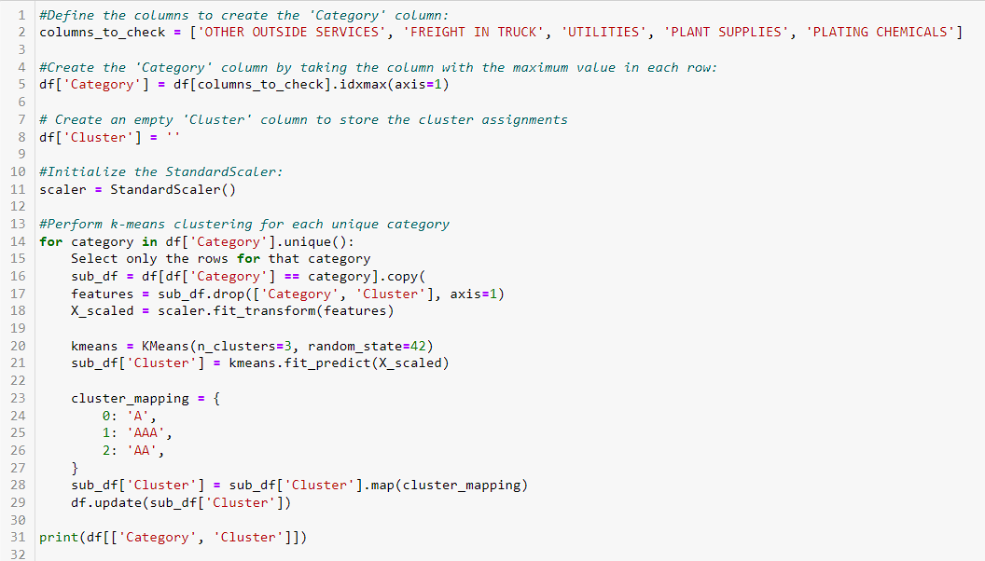
Model used
Inside the loop, the dataset is segmented into sub-dataframes based on the category being processed, and the features (excluding 'Category' and 'Cluster' columns) are standardized using Standard Scaler. Subsequently, KMeans clustering is applied to group the standardized data into three clusters (labeled 0, 1, and 2). These cluster labels are then mapped to 'A', 'AAA', and 'AA' respectively.

Slide 6
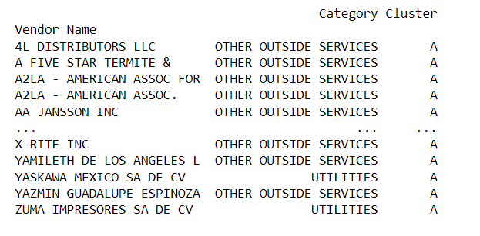
Result
The result was the dataframe listing all suppliers based on the Category and ranking / cluster provided, which was assigned based on Total Amount paid and Total transactions.
It is expected to have more A class, then less AA and way less AAA class suppliers.

Slide 7
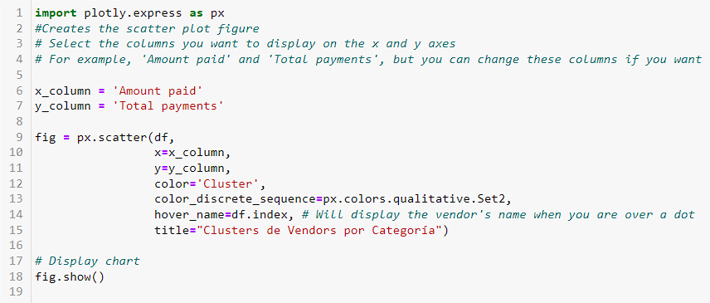
Plotly
The plotly.express library is imported to visualize data. The scatter plot is constructed using two columns from df, 'Amount paid' and 'Total payments' as the x and y axes, respectively. The points in the scatter plot are colored based on the 'Cluster' column (A, AA and AAA).

Slide 8
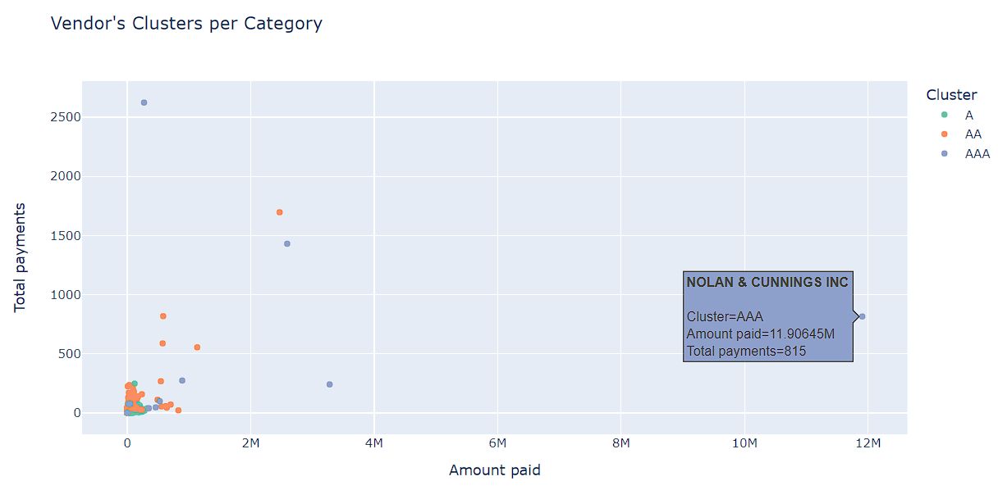
Result
This is a dynamic chart, even when you move the cursor over any dot, will provide you the detail of the supplier including the cluster, total amount paid and total payments. This chart also allows you that when you click on the cluster on the top right of the screen, you will be able to hide or visualize an specific cluster.

Slide 9
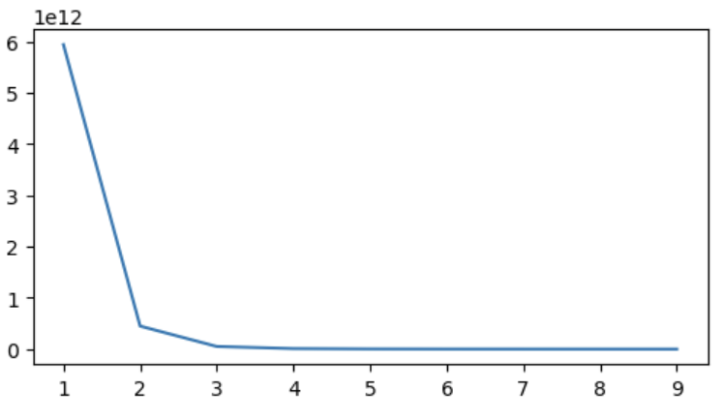
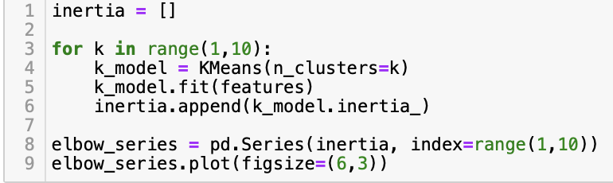
Elbow method
To find the best number of clusters, we created the elbow method with up to 10 different clusters. Between 2 and 3 were the best number of clusters, we decided to go with 3.

Slide 10
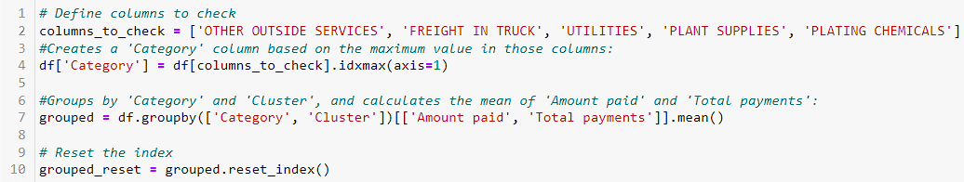
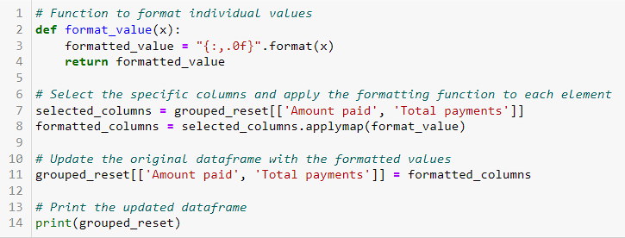
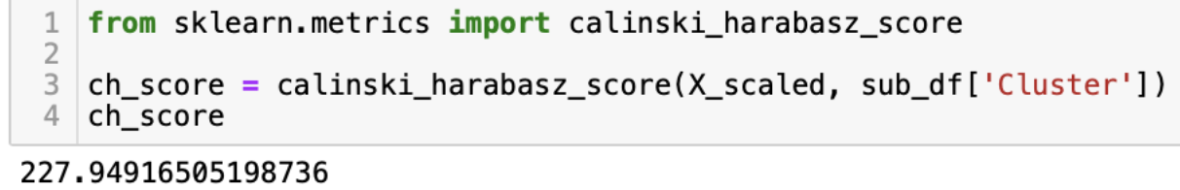
Summary
This code was used to create a dataframe as a summary to explain non supervised ML results. Based on Category and clustering developed during our model.
CALINSKI HARABASZ score

Slide 11
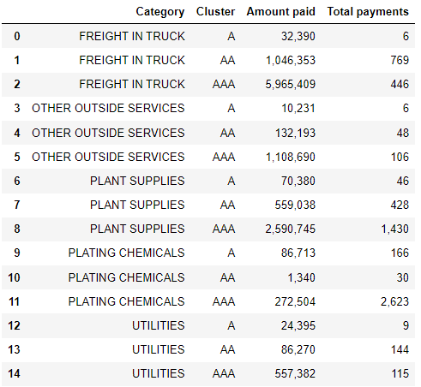
Result
Here is the final data, including the summary of supplier per category (Top five), per cluster (ranking), the amount paid and total payments.
It was expected AAA Suppliers to include highest amount paid and / or more payments done to these suppliers.
Now the company will focus their efforts on maintaining good relationship on those AAA suppliers.

Slide 12
Thank you!

